Slide 1

Retail Sales Analysis
Presented by: Pawar Nikhil

Slide 2
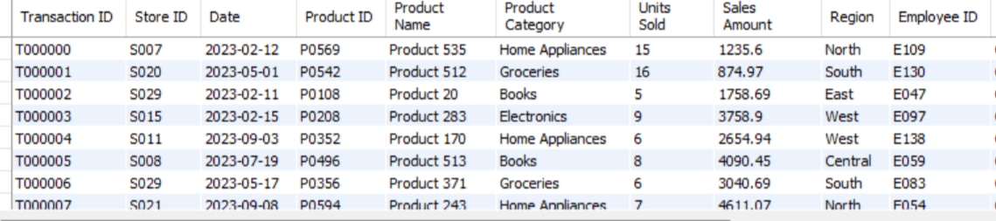
overview of Transaction Dataset:

Slide 3
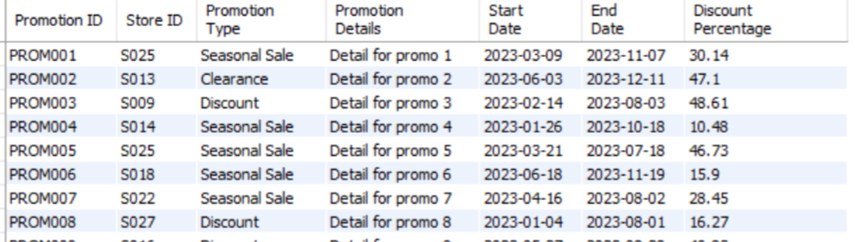
overview of Promotion Dataset:

Slide 4
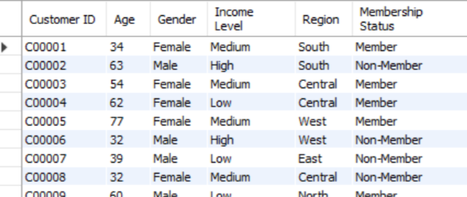
overview of Store Dataset:

Slide 5
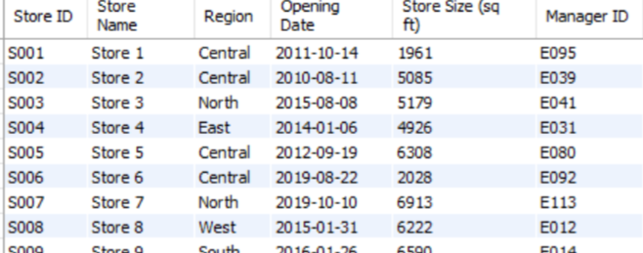
overview of Customer Dataset:

Slide 6
About The Dataset
This project involves analyzing transactional, demographic, store, and promotional data from a retail business using SQL. The objective is to uncover key business insights such as customer buying behavior, regional sales performance, product trends, and the effectiveness of marketing promotions.
Using SQL queries, the data from multiple sources was joined, cleaned, and analyzed to answer critical business questions and provide actionable recommendations. The project helps simulate real-world business intelligence scenarios through hands-on use of SQL joins, aggregations, window functions, and data cleaning techniques.

Slide 7
Objectives
To perform end-to-end data analysis on retail sales using SQL by integrating transactional, customer, store, and promotional data. The goal is to generate actionable business insights related to customer behavior, product performance, regional trends, and the effectiveness of promotional campaigns.
This analysis aims to support strategic decision-making in marketing, operations, and sales optimization.

Slide 8
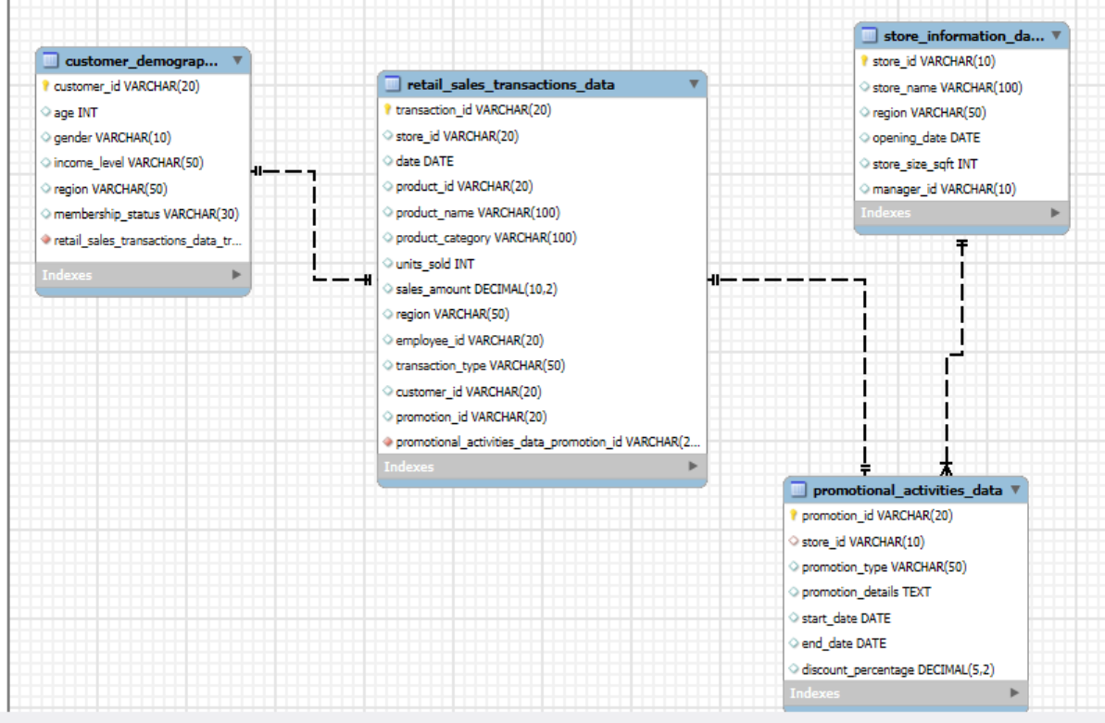
Relationship Between dataset

Slide 9
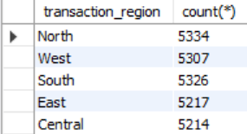
Analysis: 1
How many total transactions occurred in each region?
Table Syntax:-
select transaction_region,count(*) from combine_data_table group by transaction_region;
transaction_region Table

Slide 10
Observation:
Each region shows a different volume of transactions, meaning customer or sales activity is not uniform.
Some regions contribute significantly more transactions, likely due to: More stores, Better promotions, Stronger customer base.
Conclusion:
Regions with higher transaction counts are performing well and should be analyzed further for success factors.
This regional comparison can help in targeting specific regions for improvement, ensuring overall business growth.

Slide 11
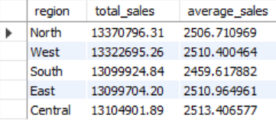
Analysis: 1.1
total and average sales amount in each region
Table Syntax:-
select transaction_region as region,
sum(sales_amount) as total_sales,
avg(sales_amount) as average_sales
from combine_data_table
group by transaction_region;

Slide 12
Observation:
Total sales vary by region — some regions contribute a significantly higher total revenue than others.
A region with high total sales and high average sales likely reflects strong customer spending and higher product value per transaction.
Conclusion:
Top-performing regions (with high total and average sales) should be reinforced with inventory, staff, and advanced promotions.
This query provides a data-driven foundation to optimize regional sales strategies and tailor business plans accordingly.

Slide 13
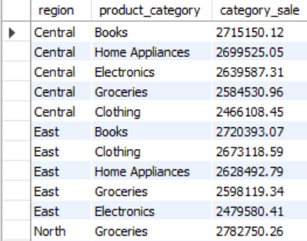
Analysis: 1.2
Which product categories sell the most in each region?
Table Syntax:-
select transaction_region as region,
product_category, sum(sales_amount)as category_sale
from combine_data_table
group by region,product_category
order by region,category_sale desc;

Slide 14
Observation:
Top-selling product categories differ by region, indicating varied customer preferences or demand patterns in different areas.
Some regions may have a single dominant product category that significantly outperforms others — a strong signal for inventory and marketing focus.
Conclusion:
High-performing category-region combinations should be prioritized for further investment or expansion.
Ultimately, this supports data-driven regional product strategy — improving customer satisfaction and maximizing sales potential.

Slide 15
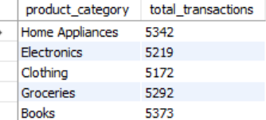
Analysis: 2
What are the distinct product categories and their total number of transactions?
Table Syntax:-
SELECT product_category, COUNT(*) AS total_transactions FROM combine_data_tableGROUP BY product_category;
transaction_region Table

Slide 16
Observation:
Some product categories have a significantly higher number of transactions than others, suggesting higher customer interest or faster-moving items.
Categories with high transaction counts but potentially low sales value (from earlier queries) could indicate low-cost or frequently purchased items.
Conclusion:
This analysis highlights which product categories are most active in sales frequency, giving insight into consumer purchasing behavior.
High-volume categories may need more inventory, frequent restocking, or additional promotional support to sustain momentum.

Slide 17
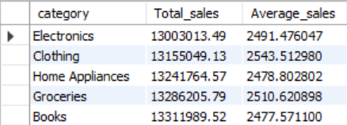
Analysis: 2.1
What is the total and average sales per product_category?
Table Syntax:-
select product_category as category
sum(sales_amount) as Total_sales,
avg(sales_amount)as Average_sales
from combine_data_table
group by category order by Total_sales,Average_sales;
transaction_region Table

Slide 18
Observation:
Some product categories have lower total sales even if they have a relatively high average sale per transaction, which could mean they are high-ticket but less frequently purchased.
Categories appearing at the bottom of the table (lowest total and average sales) might be underperforming and need business attention.
Conclusion:
This analysis helps identify top-performing product categories both in terms of total revenue and average value per transaction.
The combination of total and average sales gives a fuller picture than just looking at one metric alone — guiding strategic product decisions.

Slide 19
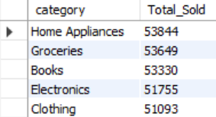
Analysis: 2.2
Which product category has the highest units sold?
Table Syntax:-
select product_category as category
sum(units_sold) as Total_Sold
from combine_data_table
group by category
order by Total_sold desc;
transaction_region Table

Slide 20
Observation:
Some product categories have sold significantly more units than others, indicating they are in high demand.
Categories at the top may contain low-cost or frequently purchased items, even if their total revenue is moderate.
Conclusion:
Product categories with high unit sales may be candidates for bulk deals or promotions, while those with low volume need deeper analysis (pricing, positioning, visibility).
Comparing total units sold with sales amount gives a powerful dual insight — what sells the most vs. what earns the most.

Slide 21
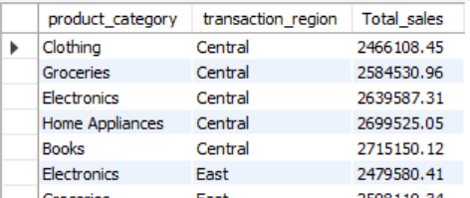
Analysis: 2.3
product category performs best in each region
Table Syntax:-
select product_category,transaction_region, sum(sales_amount) as Total_sales
from combine_data_table
group by product_category,transaction_region
order by transaction_region,Total_sales;
transaction_region Table

Slide 22
Observation:
This query provides a multi-dimensional view of how product categories perform across different regions.
This query provides a multi-dimensional view of how product categories perform across different regions.
Sales contribution of the same product category varies by region, indicating that customer preferences are region-specific.
In each region, one or two product categories dominate total sales, suggesting they align best with local demand.
Conclusion:
This query provides a multi-dimensional view of how product categories perform across different regions.
This type of grouped insight supports localized marketing, smarter stocking decisions, and targeted product focus.

Slide 23
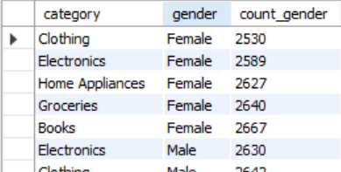
Analysis: 2.4
Which customer gender prefers which product categories?
Table Syntax:-
select product_category as category,gender
count(*) as count_gender
from combine_data_table
group by category,gender
order by gender,count_gender;

Slide 24
Observation:
Certain product categories show higher engagement from a specific gender, indicating clear preference patterns.
Some categories have a balanced count across genders, which may suggest broader appeal.
Conclusion:
This query helps identify which product categories are most popular among males vs. females.
If well used, this analysis supports inclusive marketing, better product positioning, and higher conversion rates by audience segment.

Slide 25

Analysis: 3
What is the gender distribution of customers?
Table Syntax:-
SELECT gender, COUNT(*) AS total_customers
FROM combine_data_table
GROUP BY gender;

Slide 26
Observation:
One gender (e.g., male or female) may have more transactions, indicating higher participation or engagement in the dataset.
If the gender distribution is balanced, it reflects a broadly targeted customer base.
Conclusion:
This analysis gives a quick snapshot of customer activity by gender.
It’s a valuable input for further segmentation — combining with age, income, region, or product category can produce even deeper insights.

Slide 27

Analysis: 3.1
What is the average age and units_sold of customers by gender?
Table Syntax:-
select gender,
avg(age) as Avergae_Age,
avg(units_sold) as Average_unit_sold
from combine_data_table
group by gender;

Slide 28
Observation:
This query helps connect demographics (age) with purchase patterns (units sold) across genders.
One gender may show a higher average age, indicating a more mature customer segment.
These insights can reflect lifestyle and shopping behavior differences by gender, which can help in audience targeting.
Conclusion:
This query helps connect demographics (age) with purchase patterns (units sold) across genders.
If one gender is older and buys more, promotions for that segment could focus on family packs or discounts.

Slide 29

Analysis: 3.2
On Basis of gender what is count of membership_status?
Table Syntax:-
select gender,
count(*) as membership_status,
max(store_region) as maximum_region,
min(store_region) as minimum_region
from combine_data_table
group by gender;

Slide 30
Observation:
Each gender shows a different count of transactions, reflecting their activity or engagement.
If there's a difference, it might reflect regional shopping behavior or demographic concentration.
If both genders have the same min and max region, they likely engage across all stores evenly.
Conclusion:
This query gives a surface-level view of how male and female customers are distributed across regions.
The transaction count (currently misnamed as membership_status) could reflect general gender engagement

Slide 31
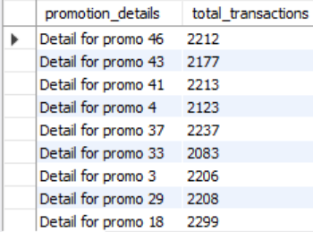
Analysis: 4
How many transactions occurred under each promotion detail?
Table Syntax:-
SELECT promotion_details,
COUNT(*) AS total_transactions
FROM combine_data_clean
WHERE promotion_details IS NOT NULL
GROUP BY promotion_details
ORDER BY total_transactions DESC;

Slide 32
Observation:
Understanding which promotions drove more transactions can guide future campaign planning.
A few promotions might dominate overall activity, which may suggest over-reliance on specific offers or their popularity.
Conclusion:
This analysis identifies the most impactful promotions in terms of volume.
This insight supports data-driven marketing strategy, helping to invest in campaigns that truly drive customer action.

Slide 33
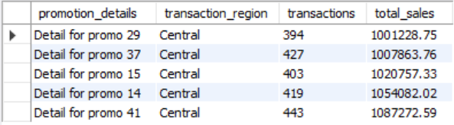
Analysis: 4.1
Which regions respond best to each promotion detail?
Table Syntax:-
select promotion_details,transaction_region,
count(*) as transactions,
sum(sales_amount) as total_sales
from combine_data_table
where promotion_details is not null
group by promotion_details,transaction_region
order by transaction_region,total_sales limit 5 desc;

Slide 34
Observation:
Some promotions work exceptionally well in specific regions, suggesting region-wise preferences or better targeting.
Promotions with high transactions and high sales are likely strong performers and can be replicated in other regions.
Conclusion:
This analysis highlights which promotions generate the most revenue by region.
It's a powerful basis for region-specific marketing and promotional planning.

Slide 35
Thank you

